Slide 1
Drexel Faculty Awards Information Session:
Faculty Research, Scholarship, Creativity Awards and Provost Awards
Information Session: Drexel Research, Scholarship and Creativity Awards & Provost Awards

Slide 2
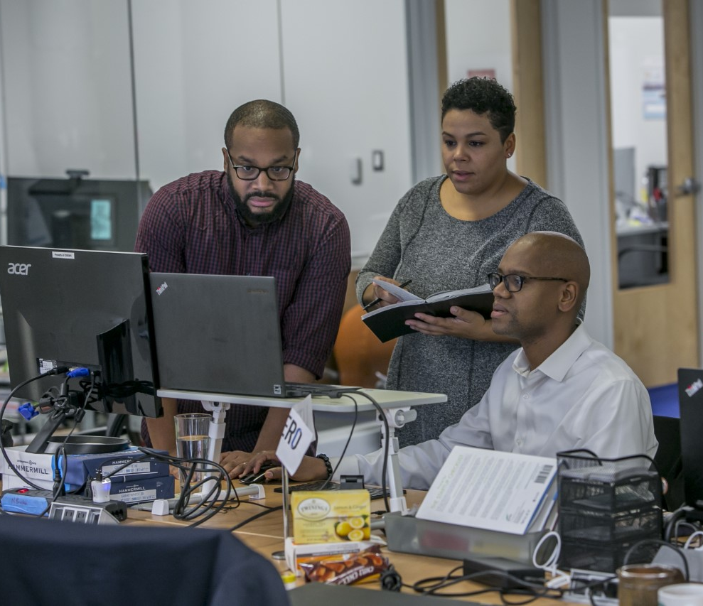
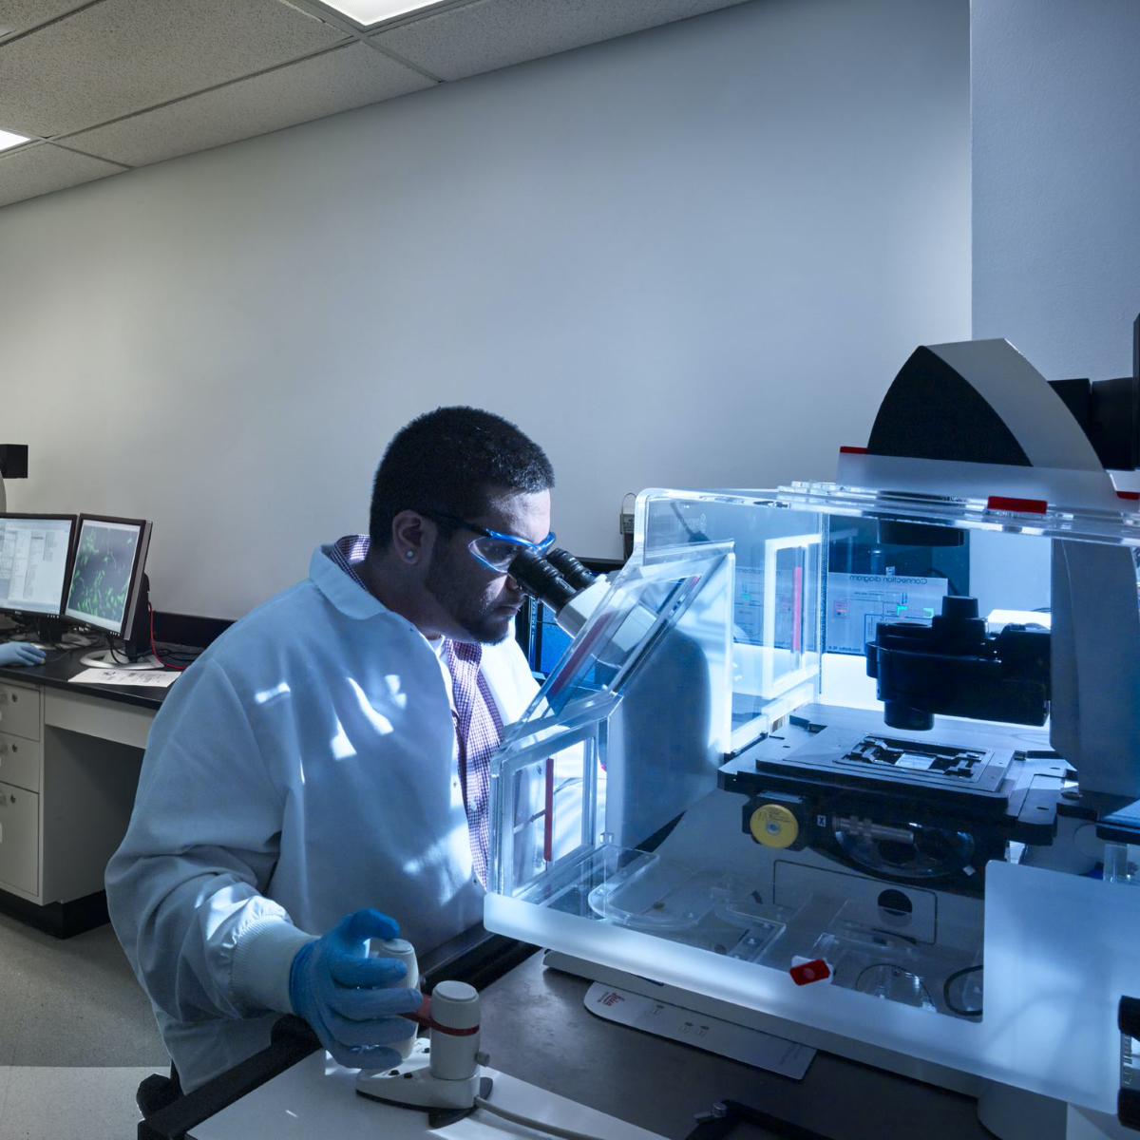

To support the ongoing development of faculty research, scholarship, and creative activities, as well as recognizing excellence in teaching, scholarship, and professional service.

Slide 3
Research, Scholarly & Creative Activity
Faculty Summer Research Award
  Full-time Faculty
  For research activities that will enhance recipient careers and increase their contributions to Drexel
Scholarly Materials and Research Equipment Awards
  Tenured/Tenure Track Faculty
  To acquire materials, equipment, software, systems, library collections or other non-personnel items that will enhance the research enterprise. Additional eligibility criteria apply.
Faculty Bridge Funding Awards
  Tenured/Tenure Track Faculty
  Provide gap funding for research programs when all other sources of funding are exhausted.

Slide 4
Research, Scholarly & Creative Activity
(continued)
Provost Award for Outstanding Scholarly Productivity
  Tenured Faculty
  For outstanding contributions to their scholarly field and demonstrated leadership
  Freddie Reisman Faculty Scholarly and Creative Activity Awards
  All Faculty
  To support scholarly and creative activities of faculty in fields and on projects where limited external funding is available.

Slide 5
Teaching
Adjunct Faculty Award for Teaching Excellence
  Adjunct Faculty members who exemplify the highest quality of teaching and mentorship of students.
Allen Rothwarf Award for Teaching Excellence
  Tenure-Track Junior Faculty members who display high standards of teaching while developing research in their areas of expertise.
Barbara G. Hornum Award for Teaching Excellence
  Teaching or Clinical Faculty
  High quality of teaching, pedagogical innovation and rigor
  Lindback Award for Distinguished Teaching
  This award recognizes outstanding teaching by three full-time members of the faculty.
Provost Award for Pedagogical Innovation
  This award recognizes full-time faculty who have implemented outstanding innovations in teaching and learning.
Provost Award for Undergraduate Teaching Impact
  This award recognizes full-time faculty who have made a distinctive impact through excellence in teaching primarily at the first- or second-year undergraduate level.

Slide 6
Service
  Harold Myers Award for Distinguished Service
  Any Drexel Community Member
  For engagement in service work that has been recognized to be truly significant to the University.

Slide 7

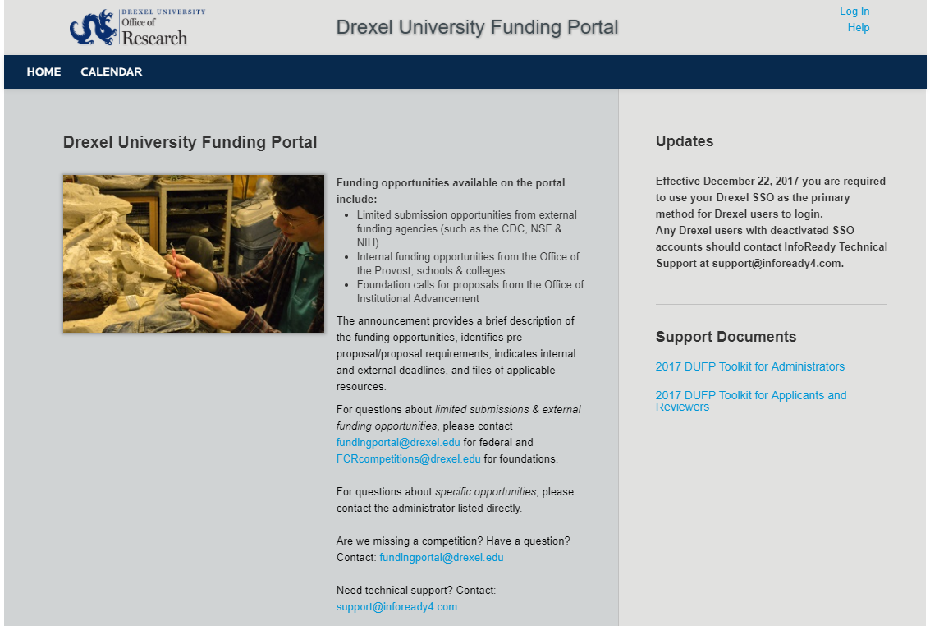
InfoReady Homepage
https://drexel.infoready4.com
Login Information
Drexel Users: You are required to use your Drexel SSO as the primary method to login. Any Drexel users with deactivated SSO accounts should contact InfoReady Technical Support at support@infoready4.com.
Non-Drexel Users: If you are a brand new user, please register to create an account. Once you have an account, enter your email address and password in the "Login for Other Users" section.
Support Documents
Toolkit for Administrators:
Funding Portal User Instructions for Administrators
Toolkit for Applicants, Reviewers, and other Users
Funding Portal Instructions for All Users
Federal Limited Submission Digest - September 2021
Federal Limited Submission Monthly Digest

Slide 8
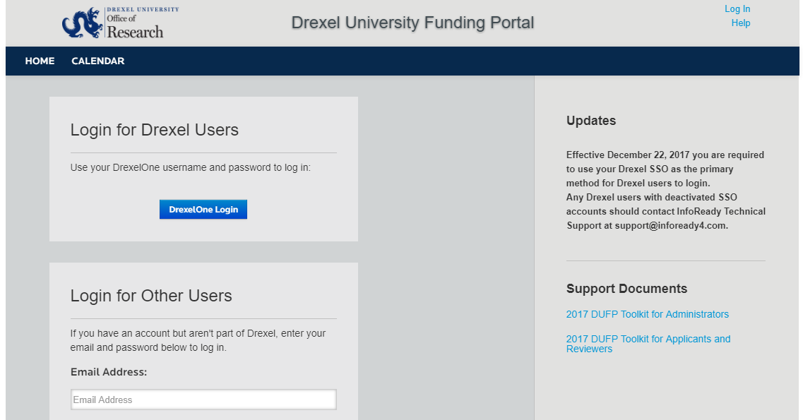
Access via DrexelOne Login

Slide 9
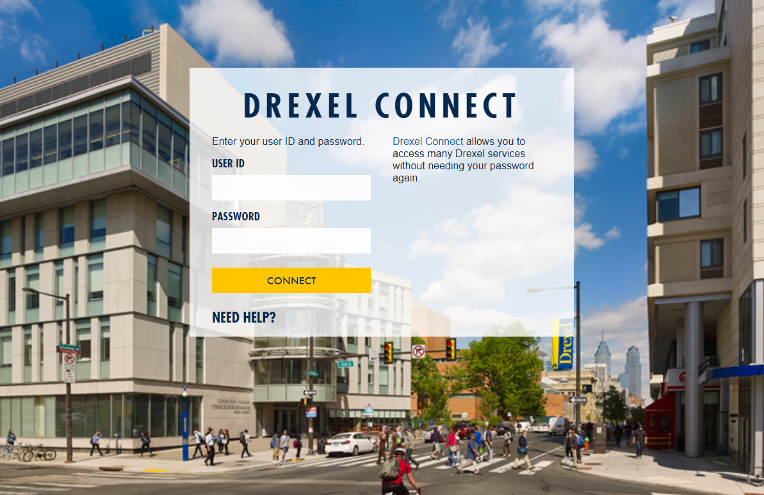
Login with Drexel Connect Credentials

Slide 10
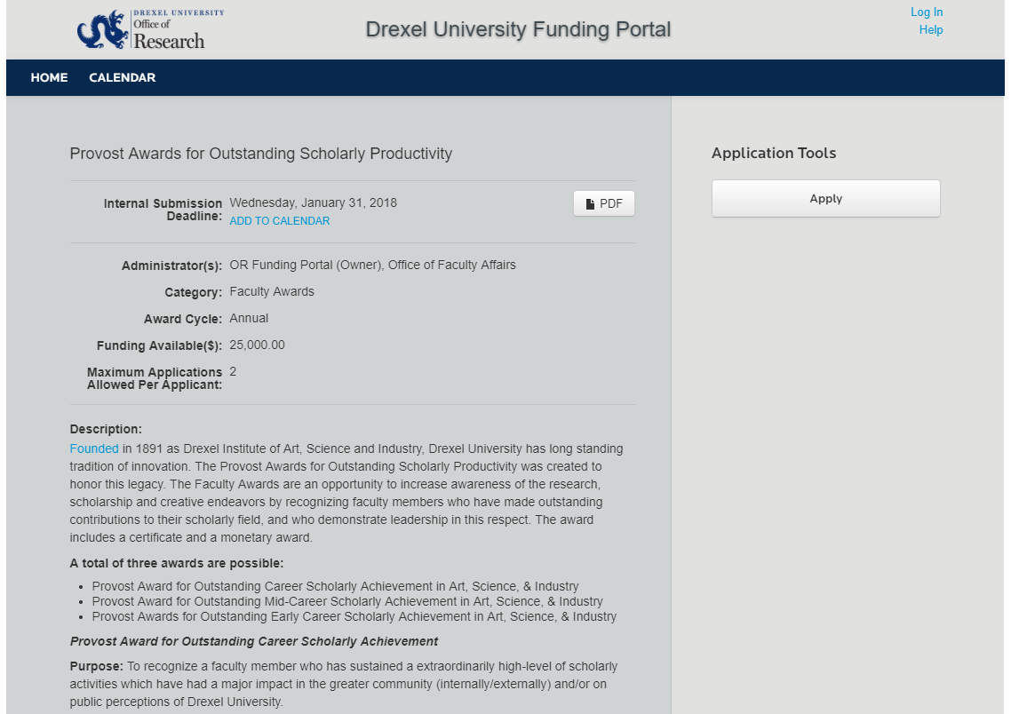
Selected Opportunity

Slide 11
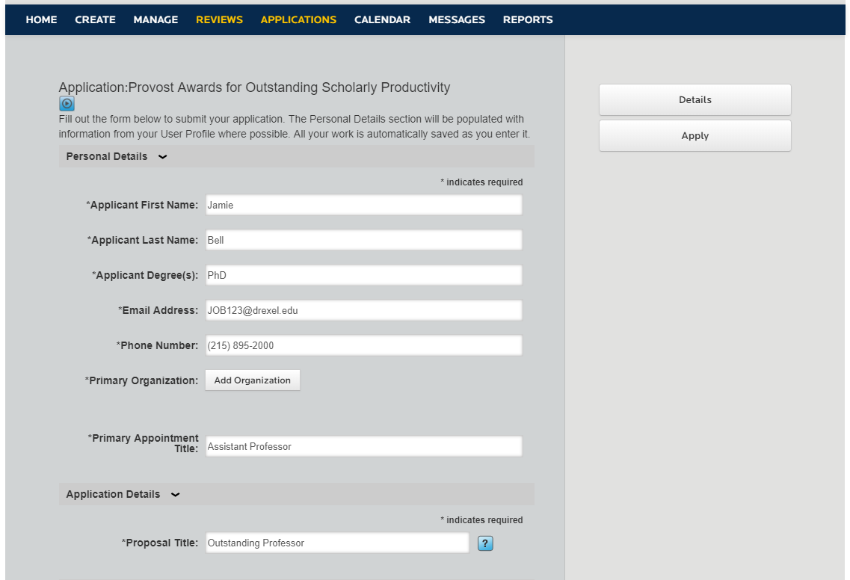
Complete Application

Slide 12
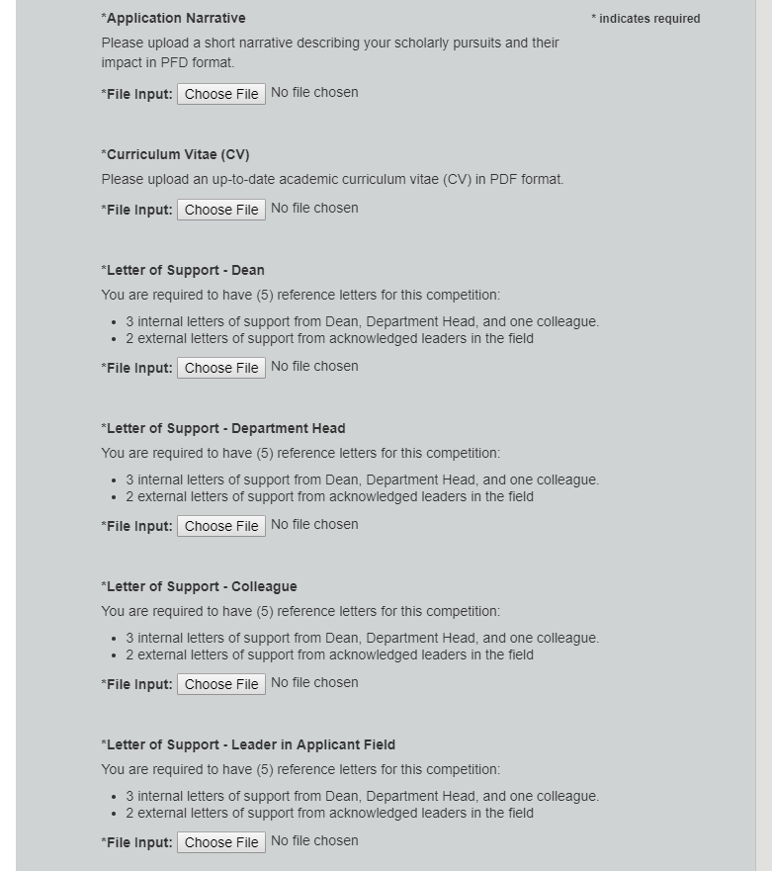
Upload Attachments

Slide 13
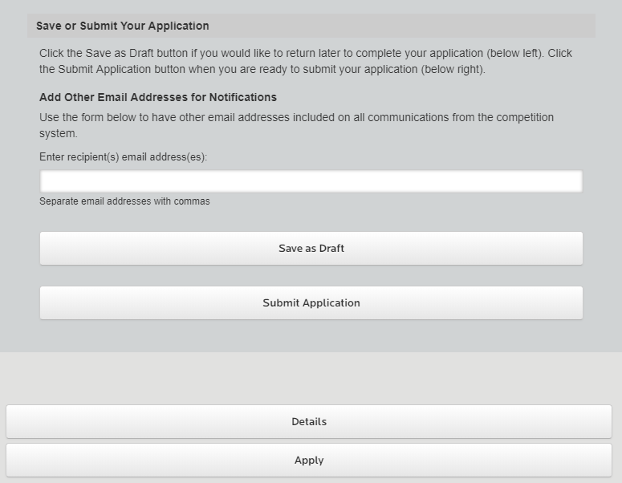
Submit Your Application

Slide 14
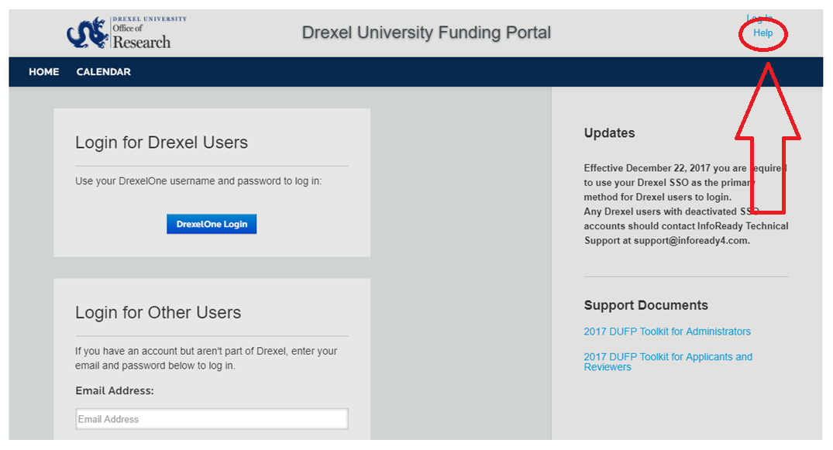
InfoReady Technical Support and
Drexel Support Documents

Slide 15
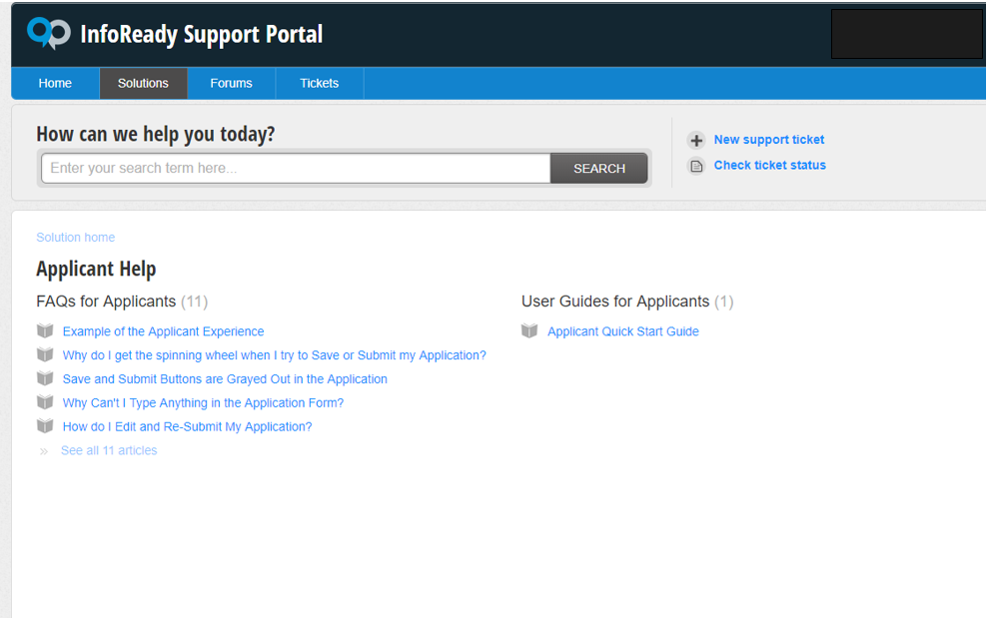
InfoReady Applicant Resources

Slide 16
Award FAQs
What can I spend the awards funds on?
Do awards come with course buy-outs?
Can the summer research award funds be used to provide faculty salary support?
Do the Provost’s Outstanding Scholarly Productivity Awards go to additive pay or are they for discretionary accounts?

Slide 17
Questions?
Faculty Award: ofaawards@drexel.edu
Drexel Funding Portal: fundingportal@drexel.edu
InfoReady Technical: support@infoready4.com

